Slide 1
Math analysis
Day 24

Slide 2
Objective
Use Circles or Rings Functions
Introduce Laces

Slide 3
From Last Time: Circles and Rings
In Bricklayer Lite Level 3
Save your ring as Name_Circle_Ring.xml
To Turn In Folder: 10_Ring_Circle_Pattern

Slide 4
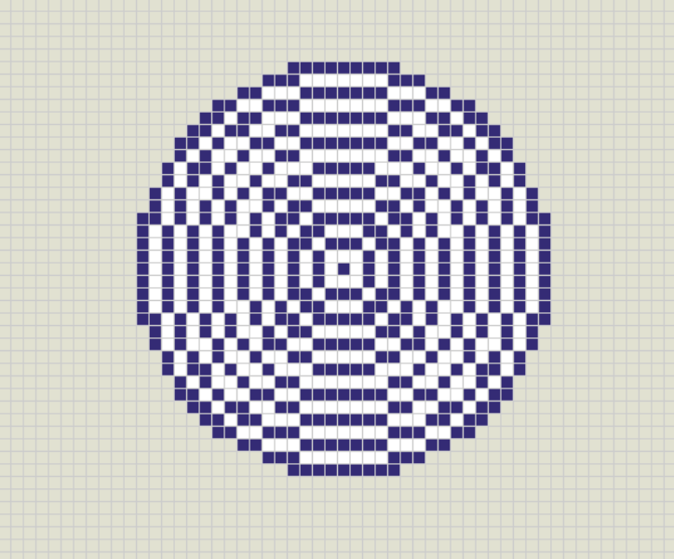
Create the following image: Consider using a function… Note: The largest ring/circle has a radius that is equal to 16

Slide 5
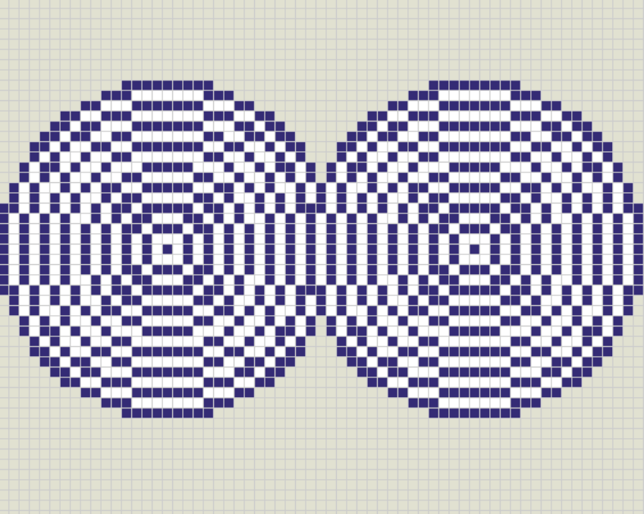
Expand on the previous function to create this object. (You can do it on the same screen)

Slide 6
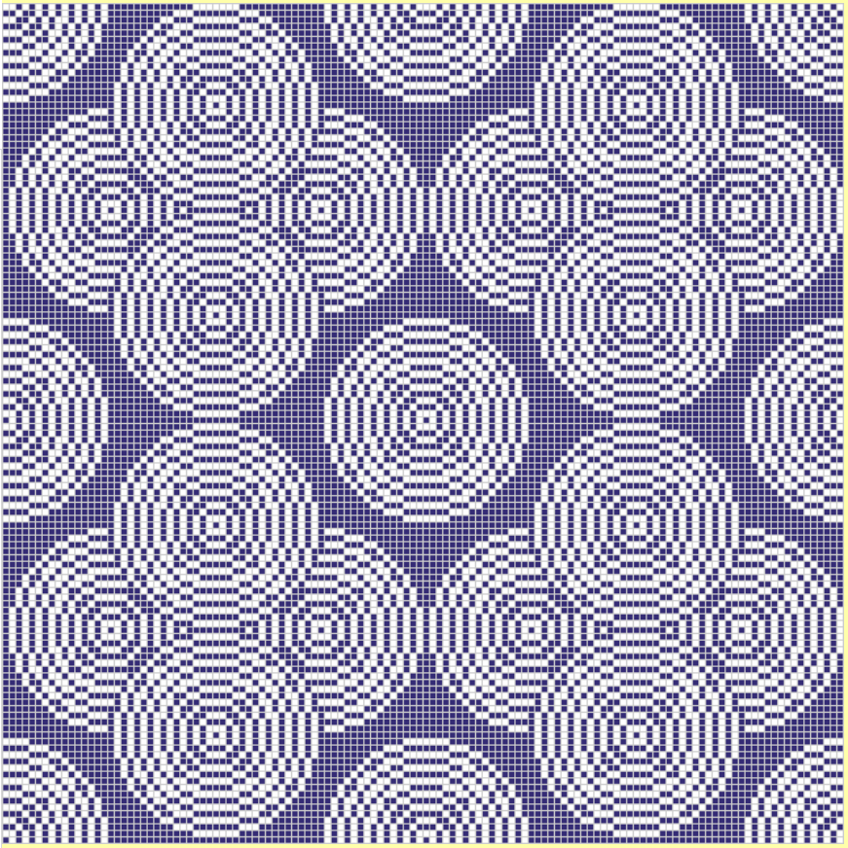
Bricklayer Lite Level 3 To Turn In Folder: 10_Ring_Circle_Pattern Save Your Object as: Name_Circle_Ring.xml

Slide 7
Explore on Your Own… Create Your Own Pattern and or Explore Laces
Things to Explore
Functions inside of functions
Repeat functions
Attempt to use the line function call (not just the put function call)
Explore the shapes function calls
Anything else you haven’t tried yet

Slide 8
Review Saving in Bricklayer Lite to Teams
Change “Filename” make sure it ends with .xml
Click Download XML
Open up Teams
Open the appropriate folder: ______________________
Click “upload” and select your recently downloaded file
Save
*Move the file to your Own Drive from your Downloads folder

